Slide 1

Basic Details of the Team and Problem Statement
Ministry/Organization Name/Student Innovation:
Ministry of Micro, Small and Medium Enterprises
PS Code: 1401 Problem Statement Title:
App-Based Solution to identify and solve disease in plants/crops
Team Name: GrowGuards Team Leader Name: Uzzma Saiyed Institute Code (AISHE): C-58356 Institute Name:
Faculty of Computer Applications and IT
Theme Name: Agriculture, FoodTech & Rural Development

Slide 2






























Idea/Approach Details
IDEA DESCRIPTION:
Farmers can use an AI-powered app to upload photos of their diseased plants. The app will identify the disease and provide recommendations for treatment. The app will also connect farmers with experts or scientists who can provide more personalized advice.
PROCESS FLOW CHART
Farmer found Disease on plant
Guidelines By Expert
One-To-One Communication
Experts + AI Predicted Solutions
Activate chatting
Capturing the
Image
Possible
Solutions
Ask To
Expert
Confuse?
TECHNOLOGY STACK
Uploading image
AI Predicted Solutions
Deep Learning
Front-End
Tech Stack
Middleware
Tech Stack
Back-End
Tech Stack
Database
Servers
Plant
Detection
Search For Possible Solutions
Identify the
Cause
Disease
Identification
Search In Datasets
For Possible Cause
Predict the
Cause
Flutter
Rest API
Python
Firebase+ MySQL
Apache

Slide 3
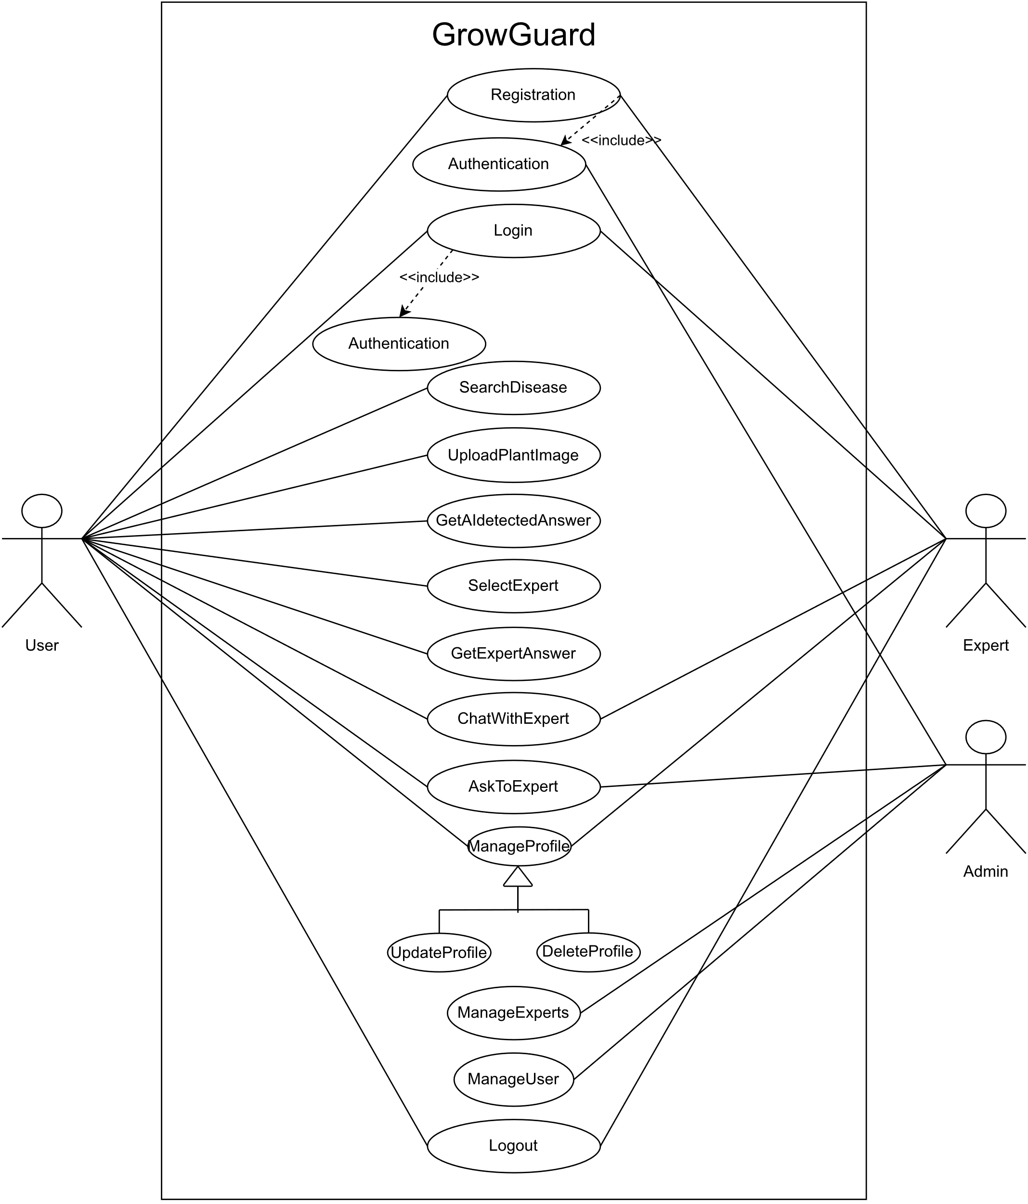






Idea/Approach Details
Use Case
SHOW STOPPER
Dependencies
With this app, farmers can simply take a photo of a diseased plant and upload it to the app. The app will then use its AI capabilities to identify the disease and provide recommendations for treatment.
The app also connects farmers with experts or scientists who can provide more personalized advice.
It can help them save time and money, improve their crop yields, and ensure that their produce is free of disease.
A large dataset of labeled plant disease images. The AI model needs to be trained on a large dataset of images of different plant diseases in order to be accurate.
A powerful computing machine. The AI model requires a lot of computing power to train and run.
A reliable internet connection. Farmers need to be able to upload photos of their plants and receive results from the app over the internet.
Possible
Solutions
Solution By App
Optional
May Not Needed in every case
Buy
Fertilizer
Farmer Applying Solution
Disease/Problem Solved
Happy Farmer

Slide 4
Team Member Details
Team Leader Name: UZZMA SAIYED
Msc. Stream (ECE, CSE etc): Year (I,II,III,IV): I
Team Member 1 Name: SMIT JOSHI
Msc. Stream (ECE, CSE etc): Year (I,II,III,IV): I
Team Member 2 Name: TEJASV MODI
Msc. Stream (ECE, CSE etc): Year (I,II,III,IV): I.
Team Member 3 Name: KHUSHI LODHA
Msc. Stream (ECE, CSE etc): Year (I,II,III,IV): I
Team Member 4 Name: DIGVIJAY JAKHANIYA
Msc. Stream (ECE, CSE etc): Year (I,II,III,IV): I
Team Member 5 Name: VISHVA RAVAL
Msc. Stream (ECE, CSE etc): Year (I,II,III,IV): I
Team Mentor 1 Name: Type Your Name Here
Category (Academic/Industry): Expertise (AI/ML/Blockchain etc): Domain Experience (in years):
Team Mentor 2 Name: Type Your Name Here
Category (Academic/Industry): Expertise (AI/ML/Blockchain etc): Domain Experience (in years):

